Slide 1
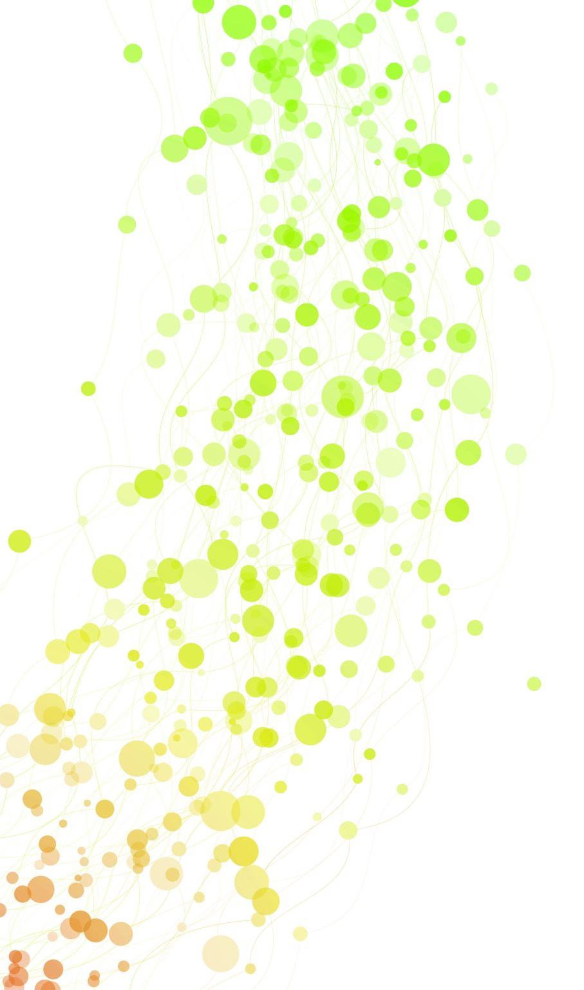
Proteome-wide Screen for RNA-dependent Proteins- non-synchronized A549 cells
Project Proposal
Anastasia Möller, Johannes Schadt, Sylviane Verschaeve, Tine Limberg

Slide 2

`We can only start to imagine the many opportunities that lie ahead´
F. Gebauer et. al (2020). RNA-binding proteins in human genetic disease

Slide 3
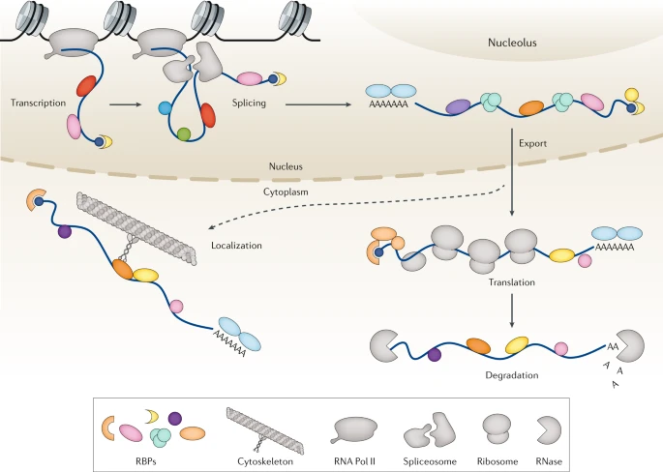
RNA-binding proteins (RBP)
RBP family is one of the largest in the cell
>4000 RBPs are already found
Control RNA life, function, efficiency -> house-keeping role
Extensive regulatory networks
Notes:
Regulate transcription, splicing, modification, intracellular trafficking, translation, decay
RNA regulates also activity of RBPs

Slide 4
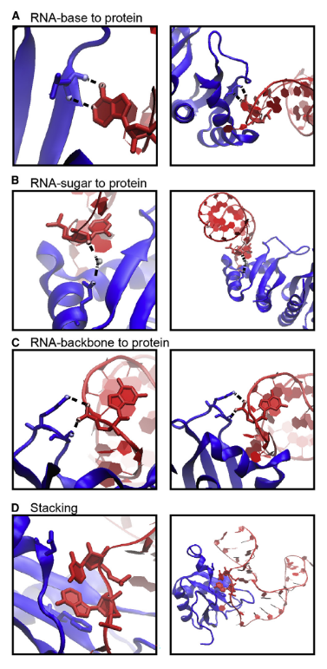
RBP interaction with RNA
Binding through hydrogen bonds & Van der Waals interactions
Interactions occur dynamically -> local rearrangements
4 typical types of interactions
Often RBPs have RNA binding domains
Combining multiple RNA binding domains in one RBP -> high specificity
Notes:
! Proteine die andere Proteine dazu befähigen an RNA zu binden erwähnen

Slide 5
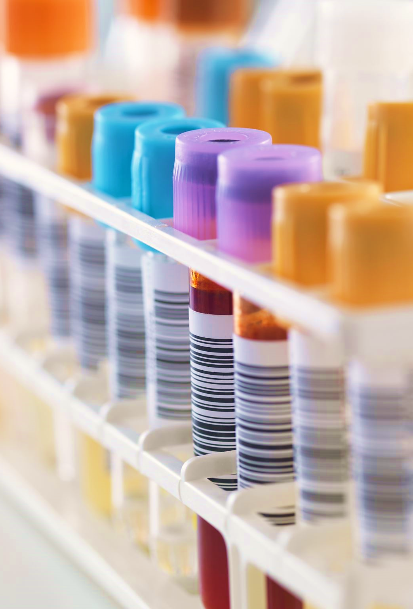
RBP related diseases
Mutations in RBP encoding genes
Malfunction underlies origin of many diseases
Tissue specific defects
-> Diseases of nervous system
-> cancer cells
Promising novel therapeutic targets
Notes:
Mutations alter RBP expression levels, truncate protein or change aminoacids (interaction with cofactors, RNA or metabolites are prevented or altered), affect (enzymatic) properties of RBPs
Nearly 1/3 of RBPs may be mutated in diseases -> already more than 1000 disease related RBPs
In mendelian disorders RBPs outnumber transcriptionfactors and other proteins regarding the prevalence of mutations
Tissue specific: because of tissue specific expression, RBPs specific because of post translational modifications
Further work is required to resolve role of RBPs in translational control and therefore in diseases

Slide 6
GOALS

Slide 7
Method

Slide 8
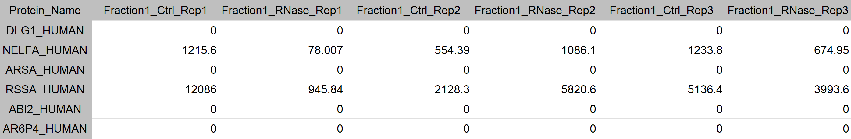
DATASET
Amount of NELFA_HUMAN
Fraction 1
Replicate 2
Control sample
150 columns
25 Fractions
3 Replicates – Control sample
3 Replicates – RNase sample
3680 rows
= proteins
Notes:
3680

Slide 9
DATASET -> genauer auf die Daten eingehen

Slide 10
Description of the dataset and evaluation of the reproducibility of the experiments
Normalization of the data to facilitate the analysis and subsequent comparison between the samples
Identification of absolut and local maxima (peaks) in the protein profiles (for each protein: distribution of its amount in the 25 fractions of each sample)
Fit of the protein profiles (optional)
Comparison of the position of the protein peaks in the control versus RNase-treated sample
Definition of selection criteria for the selection of the RNA-dependent proteins
Application of the defined criteria to automatically identify RNA-dependent proteins in the dataset.
Further analysis of the RNA-dependent proteins and RNA-independent proteins
Make a coherent report of your complete analysis and results using R markdown

Slide 12
TIMELINE
Milestone 1
Preparing dataset for analysis
1st
2nd
3rd
4th
5th
6th
7th
8th
9th
Notes:
Milestone

Slide 13


TIMELINE
Milestone 1
Preparing dataset for analysis
1st
2nd
3rd
4th
5th
6th
7th
8th
9th
Notes:
Milestone

Slide 14
1st week
-> preparing data for analysis
Description
Defining data type
Connection between data and the biology behind it
Data cleanup
Making sure all data is numeric
Setting zero to NA (to calculate mean and correlation)
Reproducibility
Correlation -> what should we do if they do not correlate -> t.test with 0.05 p-value => if failed, then discard
Connection between data and the biology behind it
Removing outlier samples
Re-ordering rows/columns in meaningful and useful ways
Notes:
change class to numeric
analysis of zero’s
normalization protein quantity
deepen biological background and research of biological question
prepare dataset for analysis
better understanding of biological question

Slide 15


TIMELINE
Milestone
Preparing dataset for analysis
1st
2nd
3rd
4th
5th
6th
7th
8th
9th
Milestone
data reduction
Notes:
Milestone

Slide 16
2nd week
Normalization of protein amount
Normalization between replicates (mean value method)
Correlation between proteins (->dimension reduction) (PCA, k-means, silhouette method)
Merge highly correlating proteins (name = name of merged proteins)

Slide 17


TIMELINE
Milestone
Milestone
Make data steady
1st
2nd
3rd
4th
5th
6th
7th
8th
9th
Milestone
Notes:
Milestone

Slide 18
identifying local maxima
Add shoulder regions
Fitting gaussian curves

Slide 19


TIMELINE
Milestone
Milestone
1st
2nd
3rd
4th
5th
6th
7th
8th
9th
Milestone
Milestone
Identification of RBPs
Notes:
Milestone

Slide 20
Plotting shift between control and RNase sample
Selection of significant shifts (p-value tests)
Comparing to protein databases

Slide 21


TIMELINE
Milestone
Milestone
Milestone
1st
2nd
3rd
4th
5th
6th
7th
8th
9th
Milestone
Milestone
Notes:
Milestone

Slide 22
Defining shifts in left and right shift
Comparison to databases (20 example proteins)
Plot overview of different shift categories

Slide 23


TIMELINE
Milestone
Milestone
Milestone
1st
2nd
3rd
4th
5th
6th
7th
8th
9th
Milestone
Milestone
Milestone
Notes:
Milestone

Slide 24
Regression model
Connection between protein function and results (for specific examples)

Slide 25


TIMELINE
Milestone
Milestone
Milestone
Milestone
1st
2nd
3rd
4th
5th
6th
7th
8th
9th
Milestone
Milestone
Milestone
Notes:
Milestone

Slide 26
Project report (pdf)
Final presentation

Slide 27


TIMELINE
Milestone
Milestone
Milestone
Milestone
1st
2nd
3rd
4th
5th
6th
7th
8th
9th
Milestone
Milestone
Milestone
Milestone
Notes:
Milestone

Slide 28
Buffer weeks

Slide 29
Team organisation
at least one meeting per week
Wednesday before tutorium
Present what we have achieved
Collect all important questions for tutorium
Use GitHub for organisation

Slide 30
Disadvantages of the Method
Proteins with leak interaction (low abondents) can be missed
Can not assess RBP affinity and specifity -> has to examine each protein individuals (functional follow up experiments)

